Slide 1

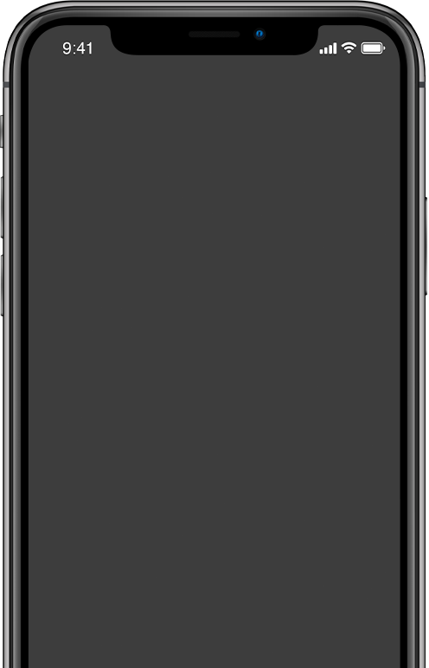
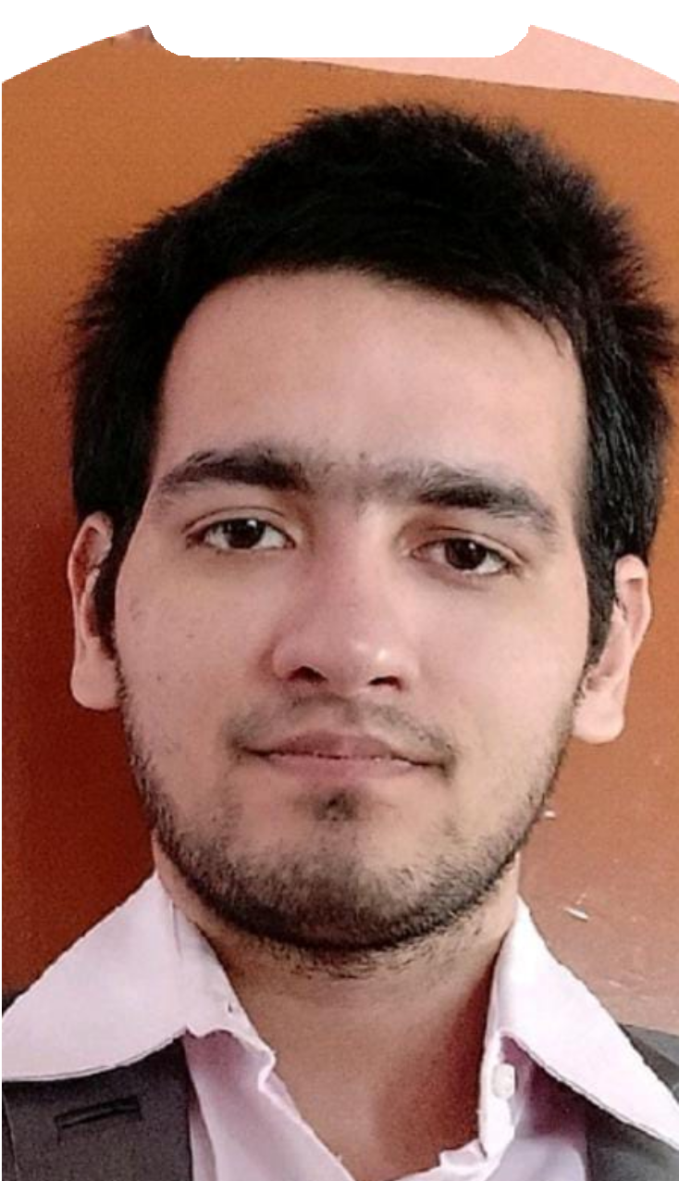


















































Full Stack Developer
INTRO
The Magic Start with us
Bablu Bambal

Slide 2
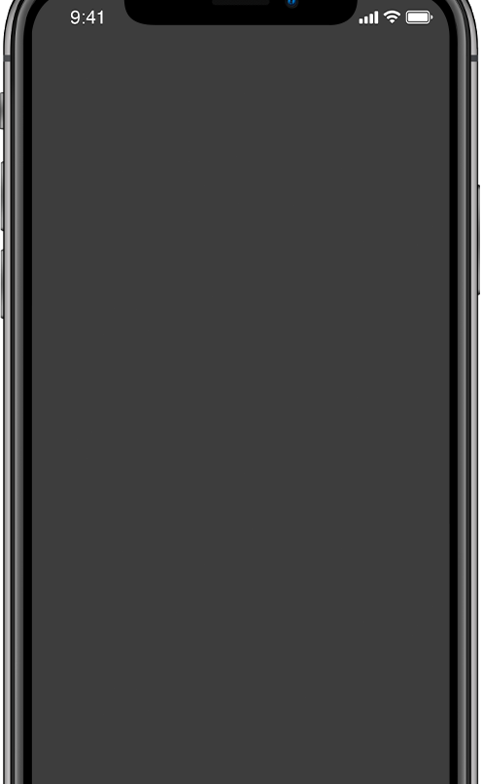


Full Stack Developer
Agenda
What is Web?
What is Website & How it works? Type of Developers ?
Technology Required.. Tools Needed and Setup ?
WHELTON SCHOOL OF MARKETING | SESSION 1

Slide 3


What is Web ?
Things
to discuss
Key takeaways:
First Website
http://info.cern.ch/hypertext/WWW/TheProject.html

Slide 4










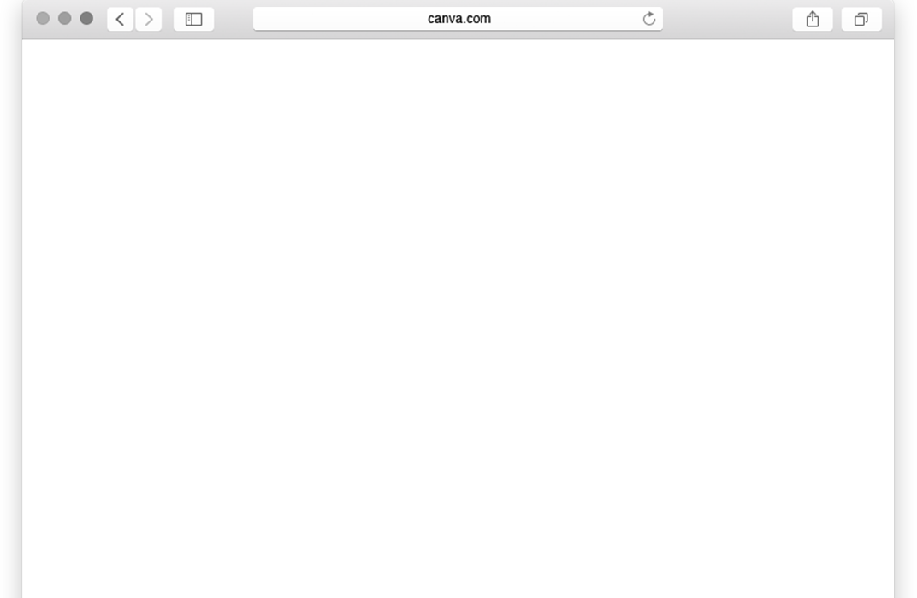

What is Website & How it Works
Server
Client
Website

Slide 5


Type of Developers
Front-End Developer
Back-End Developer

Slide 6
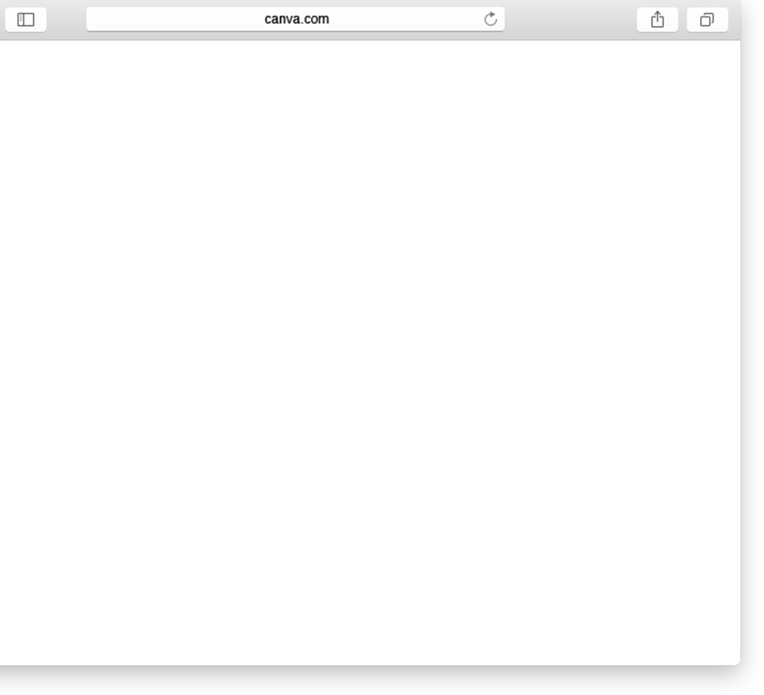

75%
Companies Now Dont Need 2 Developer

Slide 7





Full Stack Developer

Slide 8

Top 10
Editors
100
75
Brackets.io.
Atom.
Visual Studio Code.
Sublime Text 3.
Notepad++
Vim.
Komodo Edit.
Froala.
Word 10)Notepad
50
25
0
Vs Code
Bracket io
Atom
Sublime
Vim
Korola
Notepad
word
Notepad ++
Dreamveaver

Slide 9
Learning Path
Schedule

Slide 10
5+
Projects
Addons:
Benefits
+

Slide 11
Lets
Start
Code

